Slide 1


UPCOMING MRCOG DATES
Booking opens: Tuesday 29 October 2024
Booking closes: Thursday 17 December 2024
MRCOG Part 1 exam: Tuesday 21 January 2025
MRCOG Part 2 exam: Wednesday 22 January 2025

Slide 2
START YOUR MRCOG JOURNEY
Registration for the January 2025 MRCOG exams opens on Tuesday 29 October 2024

Slide 3
REGISTRATION NOW OPEN
Registration for the January 2025 MRCOG exams is now open. Bookings are allocated on a first come first saved basis

Slide 4
IMPORTANT DEADLINE
Candidates for the January 2025 MRCOG exams must register by Tuesday 17 December 2024

Slide 5
OFFICIAL REVISION BUNDLE
The official MRCOG revision bundle provides a cost-effective and flexible approach to your learning

Slide 6
BECOME AN RCOG ASSOCIATE
Unlock access to a comprehensive range of revision resources designed to support you throughout your MRCOG journey

Slide 7

Official MRCOG Part 1 Online Revision Course
4-6 December 2024

Slide 8

Official MRCOG Part 2 Online Revision Course
23-24 November 2024

Slide 9
FIVE REASONS
To take the MRCOG exam

Slide 10

GOLD STANDARD
The MRCOG is internationally recognised as the gold standard qualification in O&G

Slide 11

GLOBAL REACH
The MRCOG qualification will open up global opportunities for your career development

Slide 12

RECOGNITION
Be recognised as a global expert in women’s healthcare

Slide 13

TRUSTED
Your qualification demonstrates to your patients your commitment to the highest standards of care

Slide 14
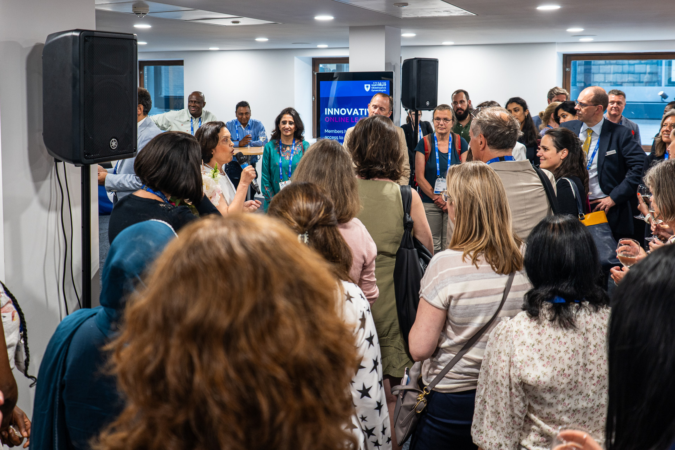
COMMUNITY
You will be joining a global network of 16,000+ O&G doctors making meaningful change to the lives of women and girls

Slide 15
FIVE REVISION TOP TIPS
How to look after your wellbeing whilst preparing for your exam

Slide 16
STAY ORGANISED
To stay focused, keep your study materials organised and in one place

Slide 17
TAKE BREAKS
Take regular breaks during your studies to avoid burnout and maintain focus

Slide 18
GET PLENTY OF REST
Lack of sleep can affect your concentration and memory, make sure you get enough sleep in the build up to your exam

Slide 19
HYDRATE AND EAT HEALTHILY
Drink plenty of water and eat healthy, balanced meals to keep your brain functioning at its best

Slide 20
STAY CALM AND CONFIDENT
Remember that you've prepared well and that you're capable of passing the exam

Slide 21
FIVE REVISION TOP TIPS
Top tips to enhance your learning experience

Slide 22
START EARLY
Don't wait until the last minute to start studying for your exam

Slide 23
MAKE A STUDY PLAN
Create a study schedule that includes all the topics you need to cover and the amount of time you plan to spend on each

Slide 24
STAY ORGANISED
To help you stay focused, keep your study materials organised and in one place

Slide 25
TAKE BREAKS
Take regular breaks during your study sessions to avoid burnout and maintain your focus

Slide 26
GET ENOUGH REST
Lack of sleep can affect your concentration and memory so make sure you get enough sleep the night before the exam

Slide 27

Find out more at rcog.org.uk/MRCOG

